Slide 1
VUE.JS vs. REACT
Comparison of simple SPA app (without and with store)
David Długosz
Notes:
Are your classroom colors different than what you see in this template? That’s OK! Click on Design -> Variants (the down arrow) -> Pick the color scheme that works for you!
Feel free to change any “You will…” and “I will…” statements to ensure they align with your classroom procedures and rules!

Slide 2
Basic info
Vue | React
129 048 ★ on GitHub 261 contributors Latest version 2.6.7 By Evan You (@youyuxi) Alibaba, Nintendo, 9GAG… | 123 293★ on GitHub 1285 contributors Latest version 16.8.3 By Facebook FB, Netflix, Uber, Twitter…
* Data from 27.02.2019

Slide 3
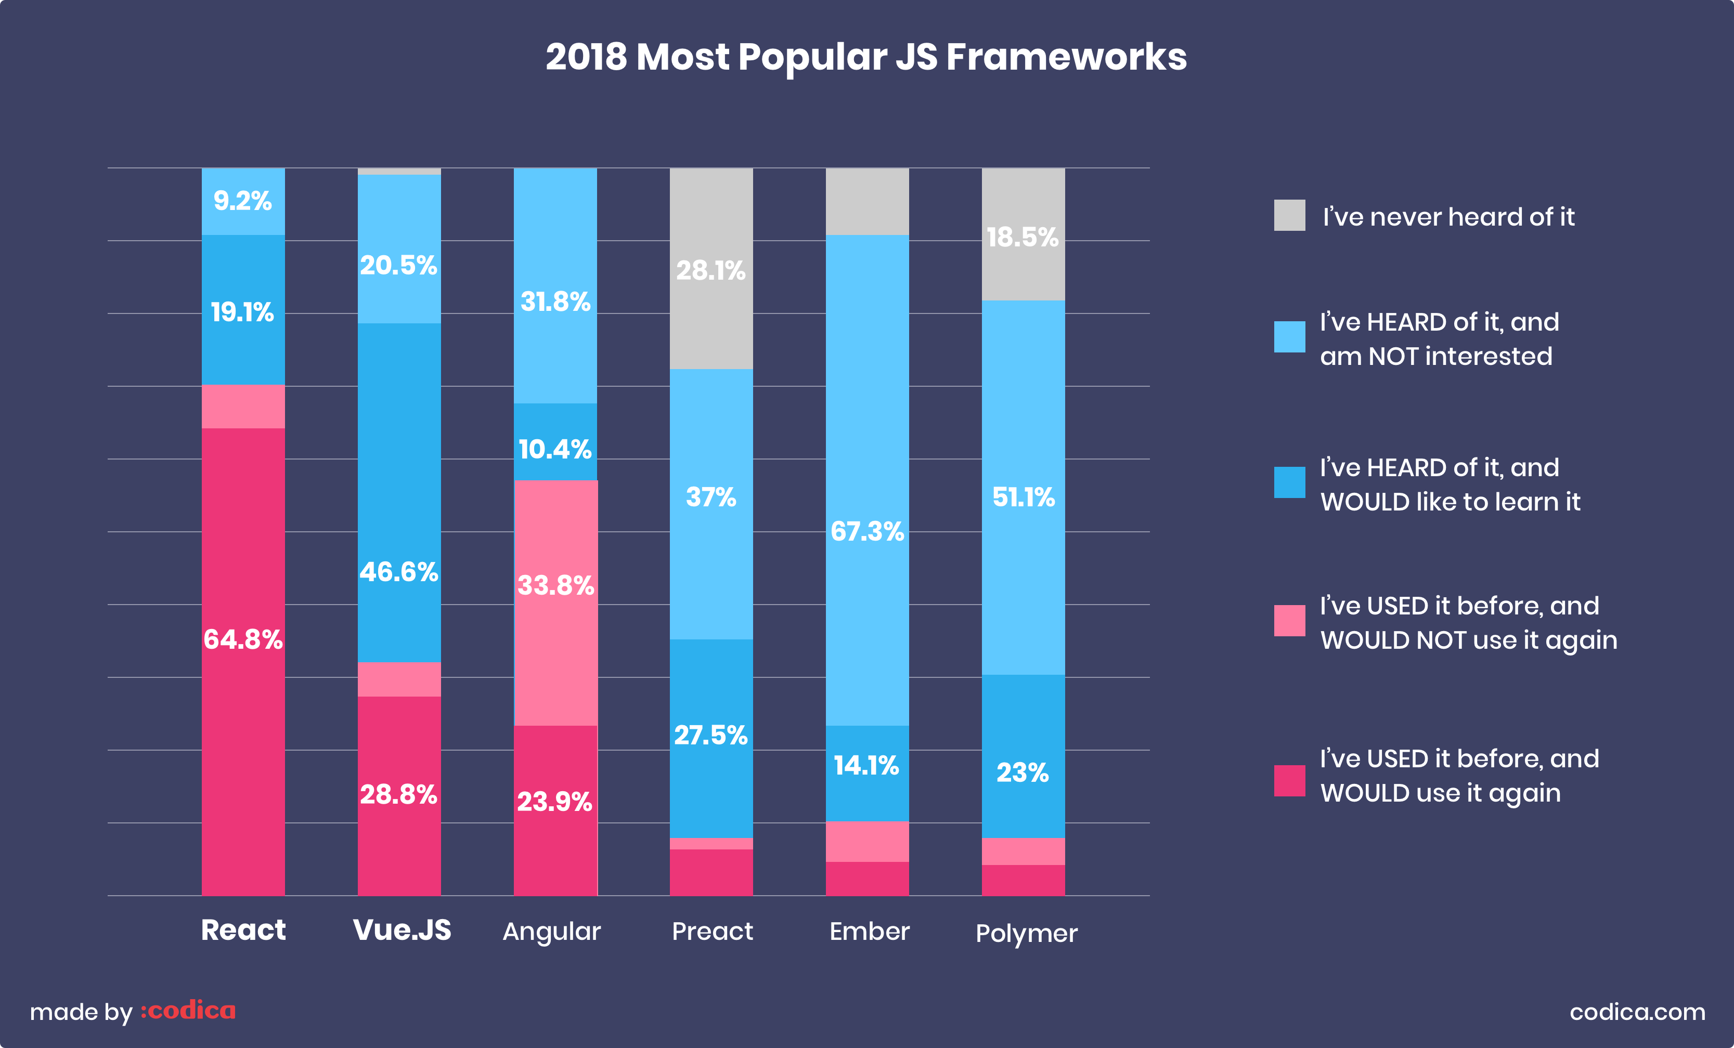

Slide 4
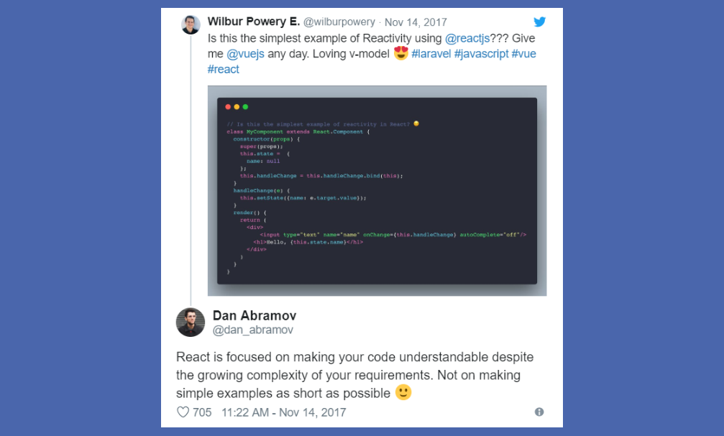

Slide 5
Similarities
Virtual DOM
Reactive, composable view components
Core libraries (routing, global state management handled by other libraries)

Slide 6
Components
Building blocks of Vue and React apps
Optional parameters
Returns element describing UI
Lifecycle events
Own data/methods

Slide 7
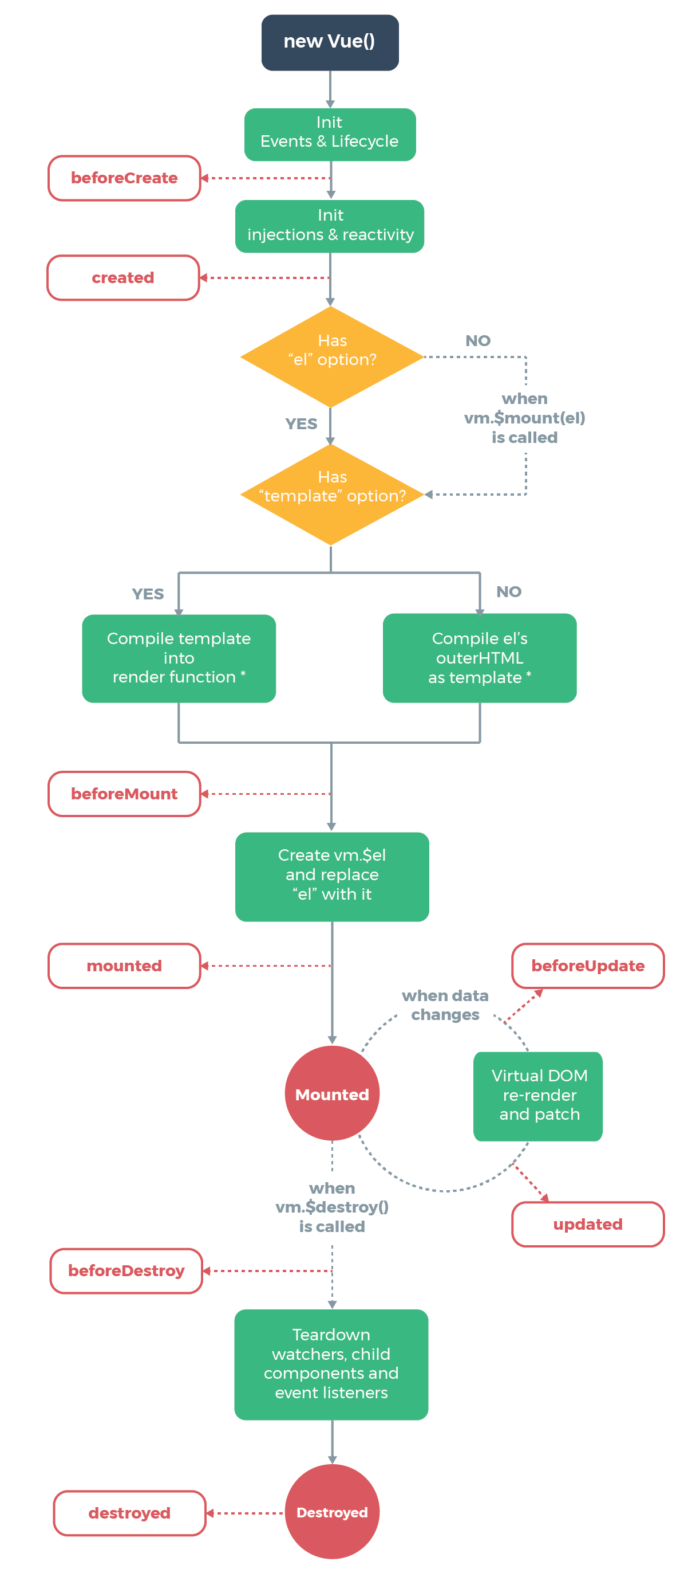
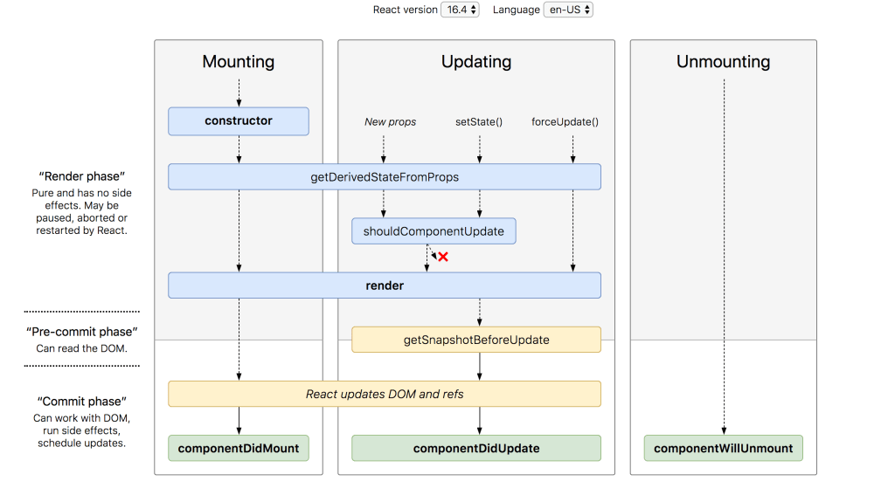
Lifecycles

Slide 8
Differences
Vue | React
Templating Newer (smaller ecosystem) Mutable state in VUEX | JSX Older (bigger ecosystem) Immutable state in REDUX

Slide 9
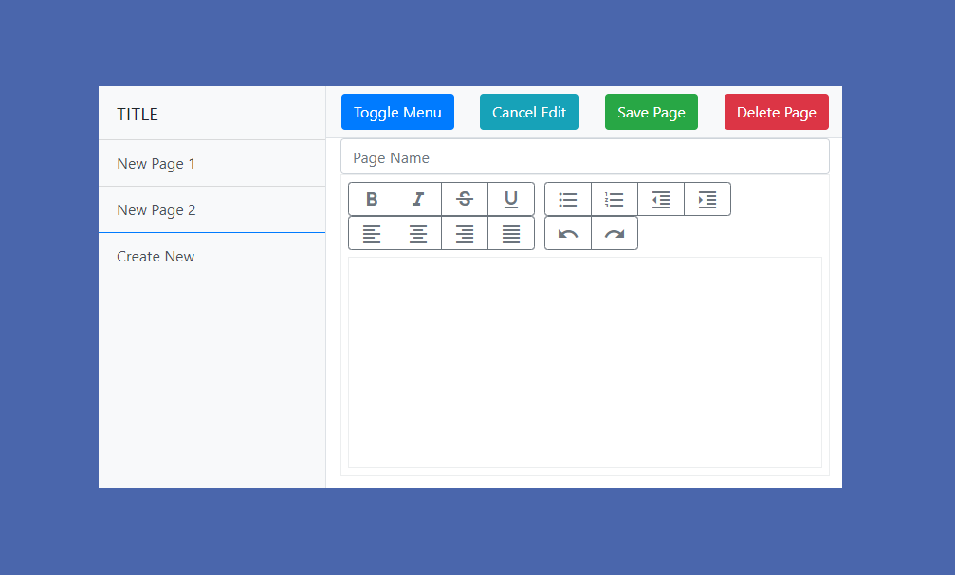

Slide 10
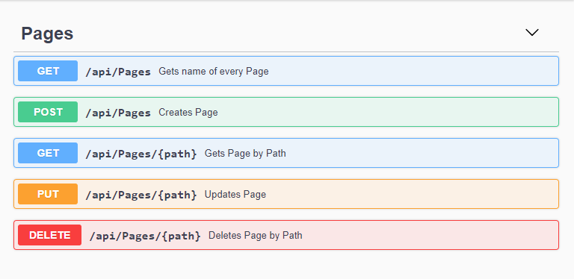

Slide 11
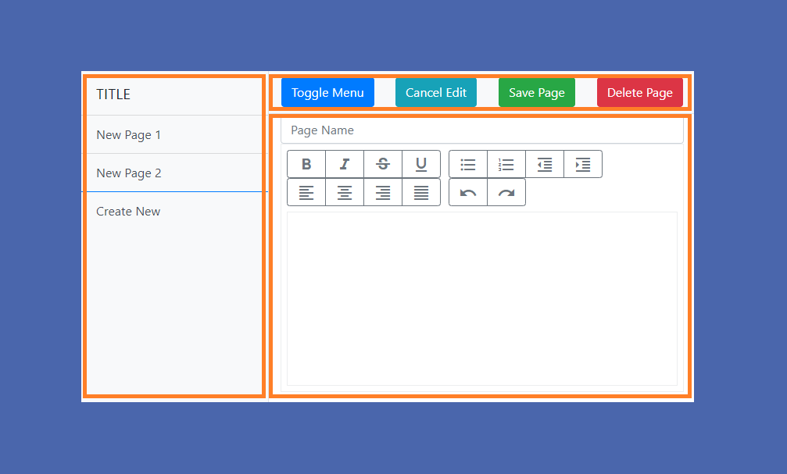

Slide 12
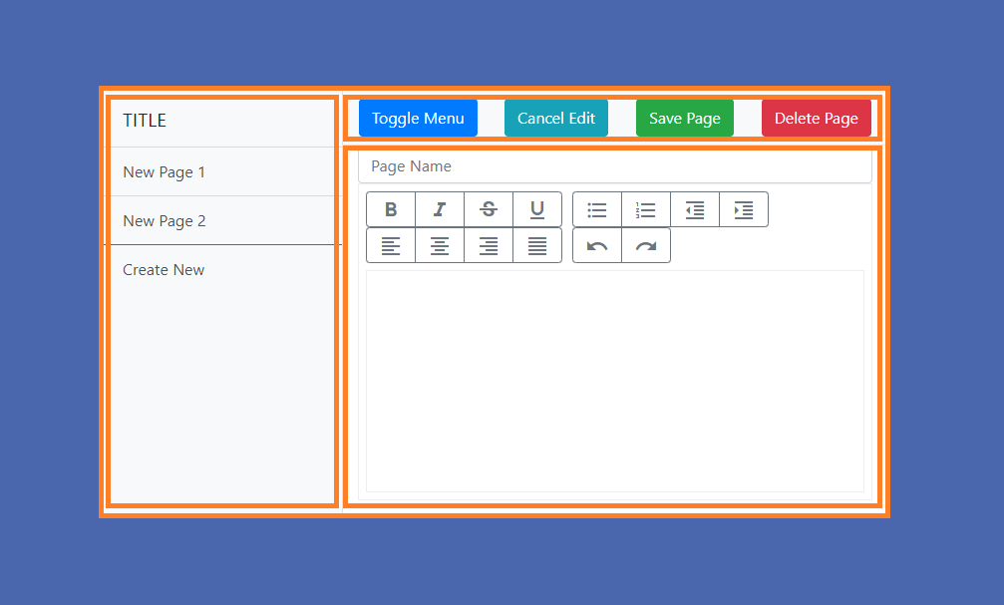

Slide 13
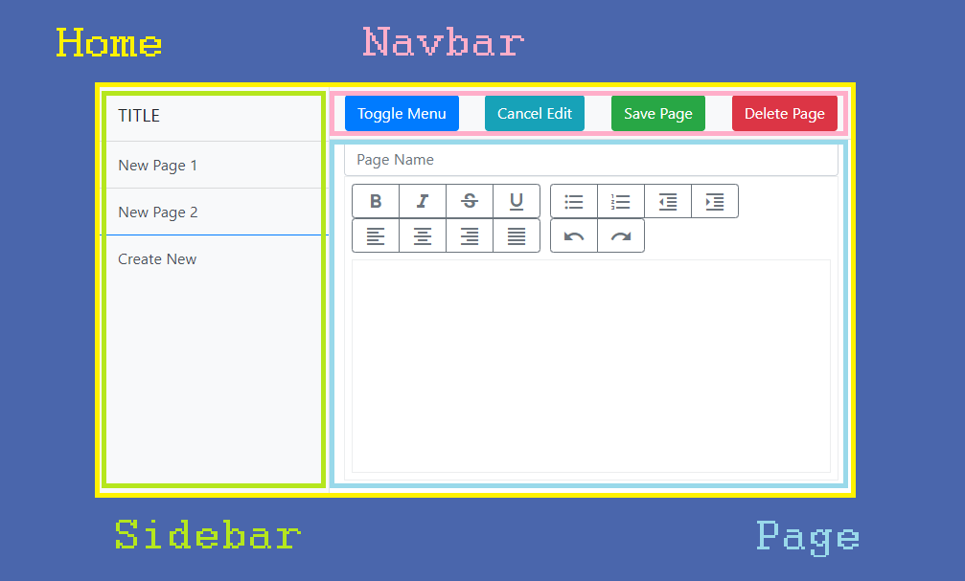

Slide 14
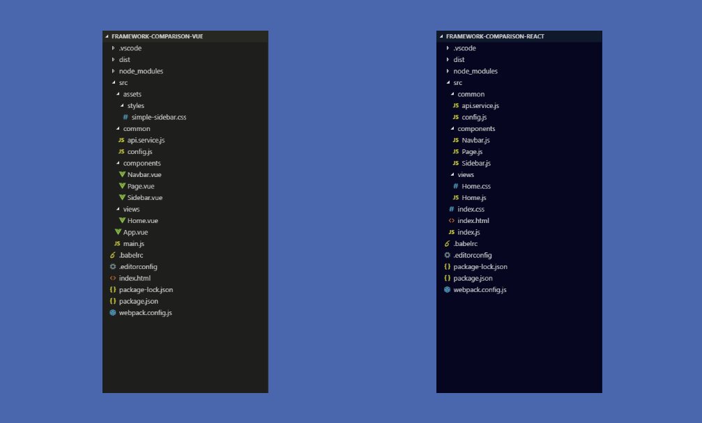

Slide 15
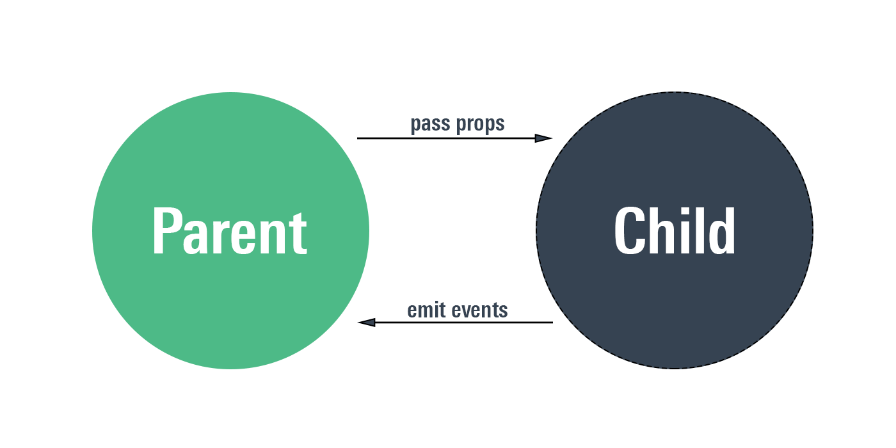

Slide 16
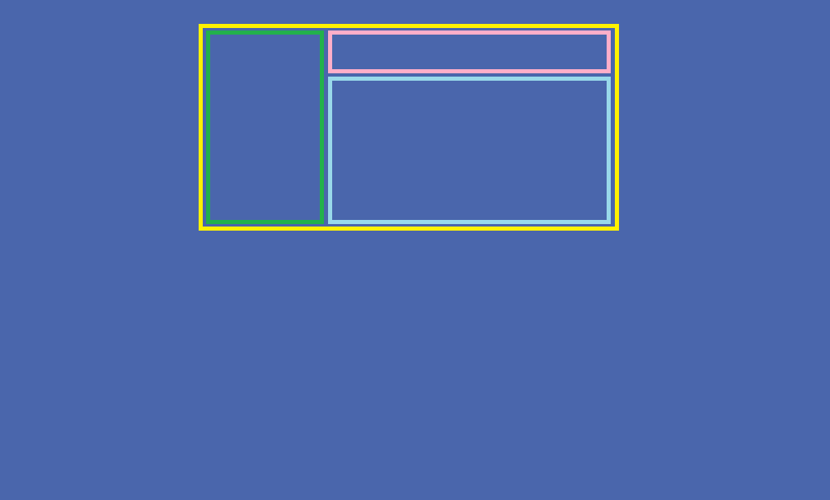

Slide 17
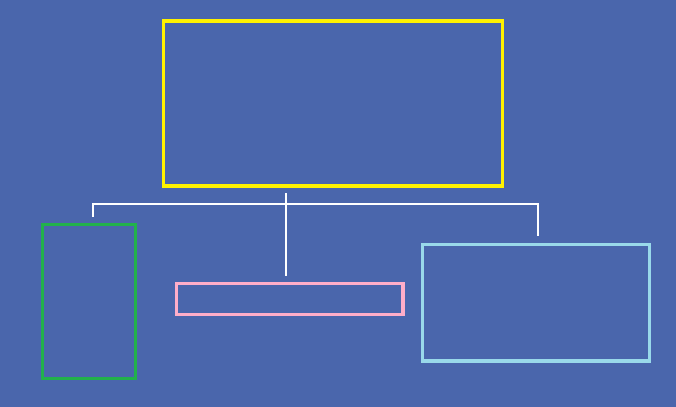

Slide 18
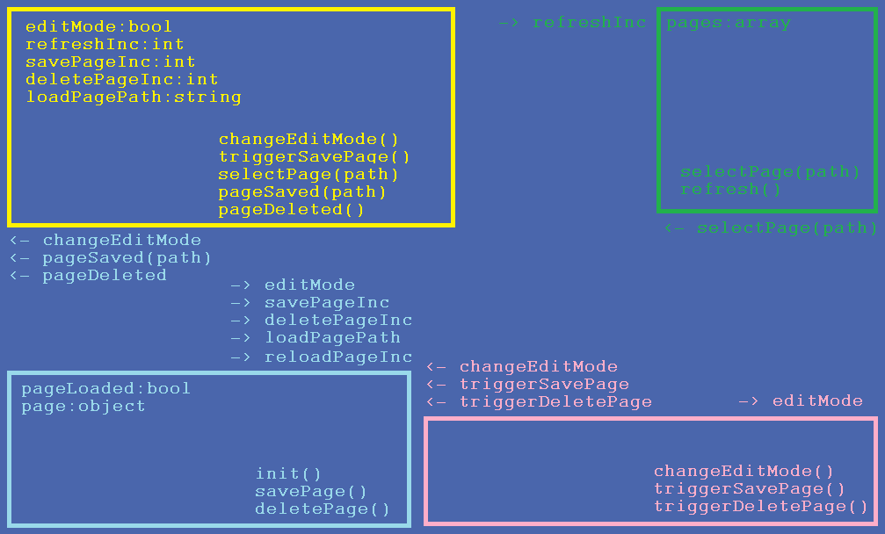

Slide 19
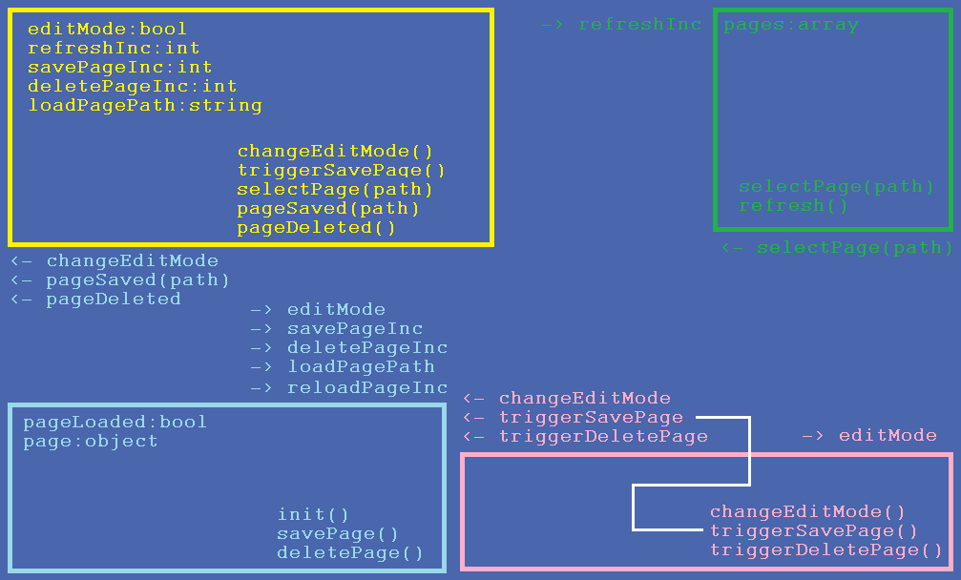

Slide 20
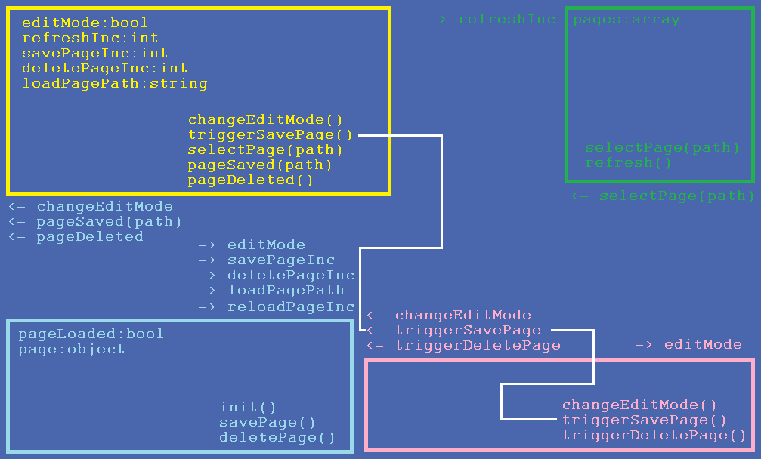

Slide 21
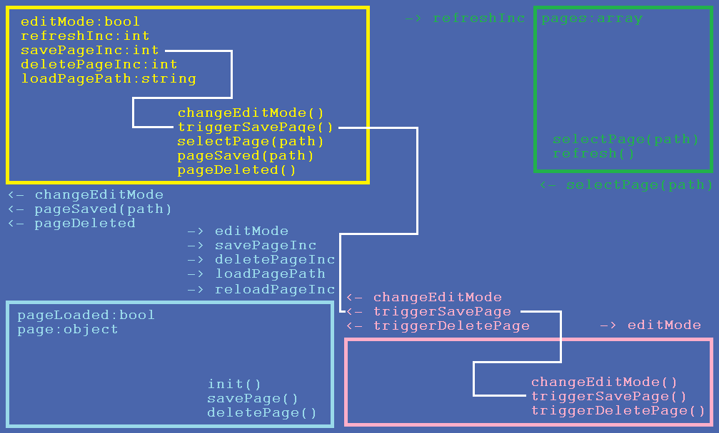

Slide 22
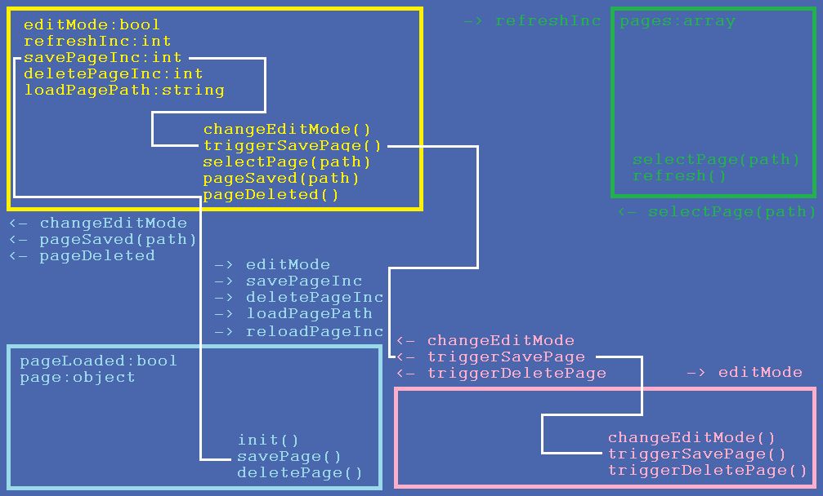

Slide 23
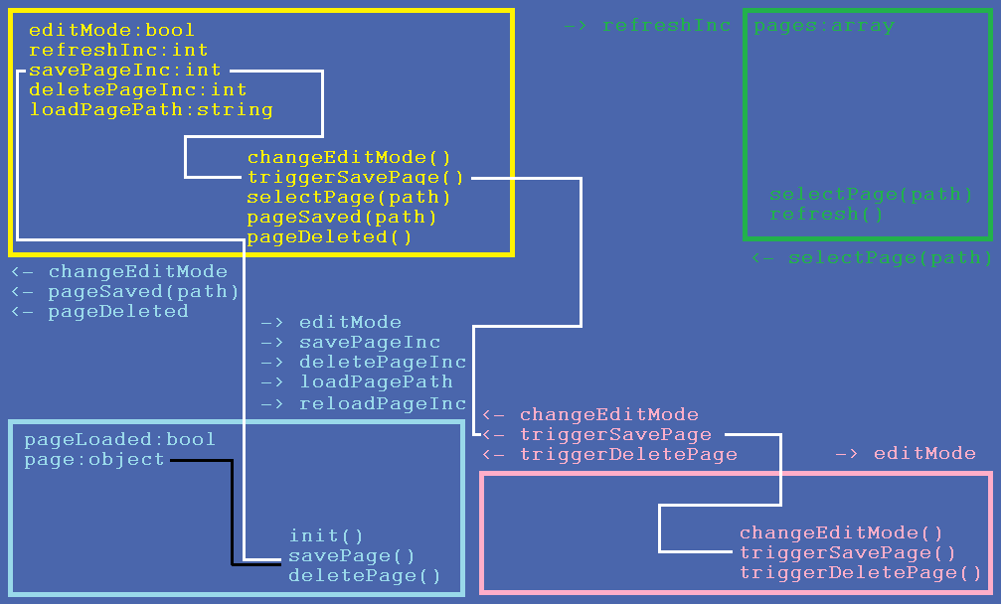

Slide 24
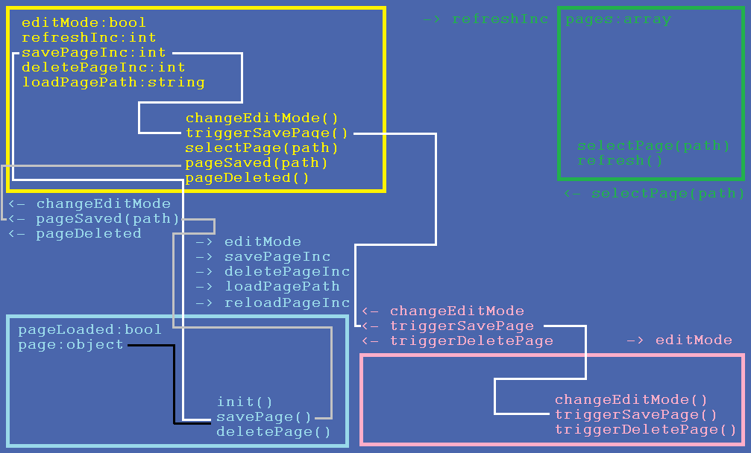

Slide 25
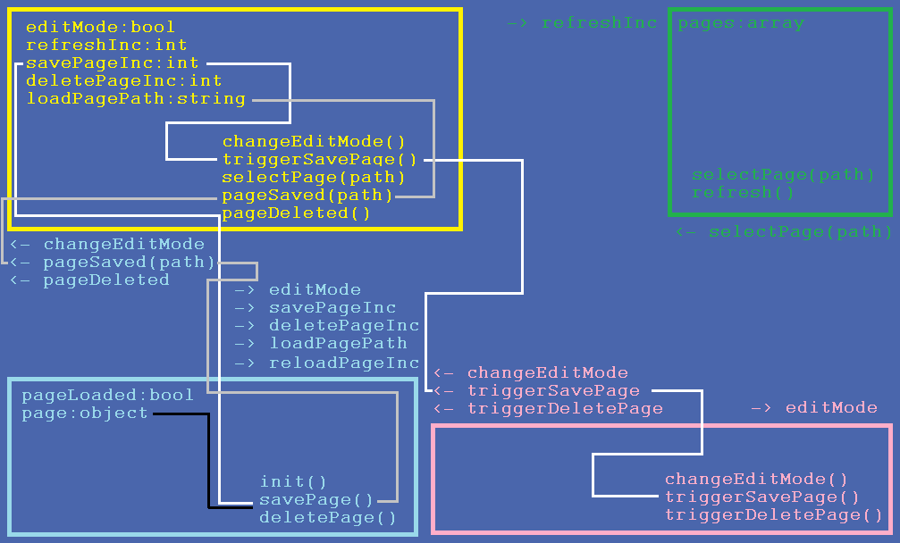

Slide 26
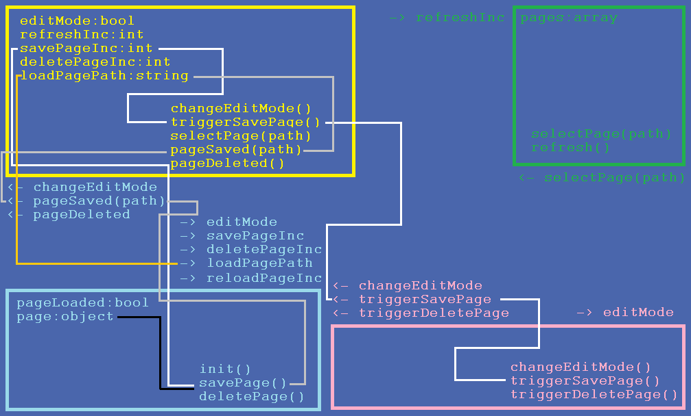

Slide 27
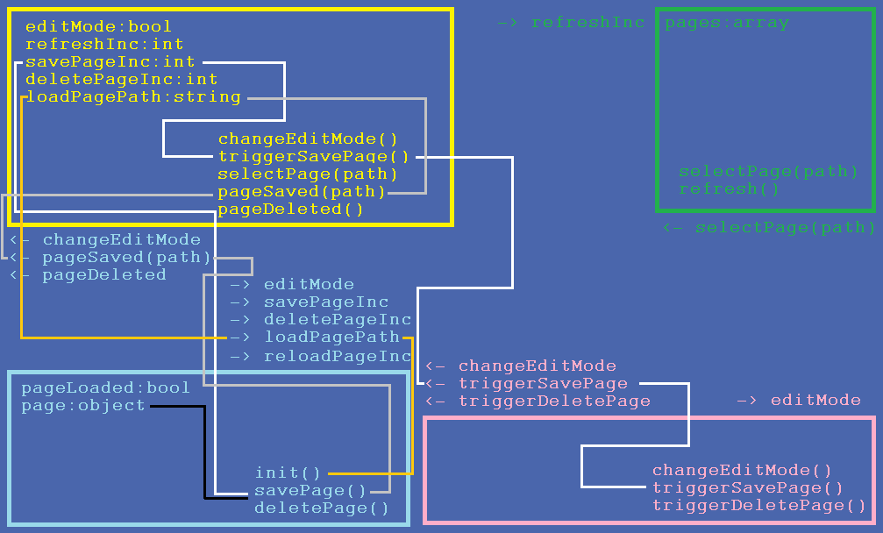

Slide 28
State management
Vue | React
Vuex Actions Mutation | Redux Actions Reducers

Slide 29
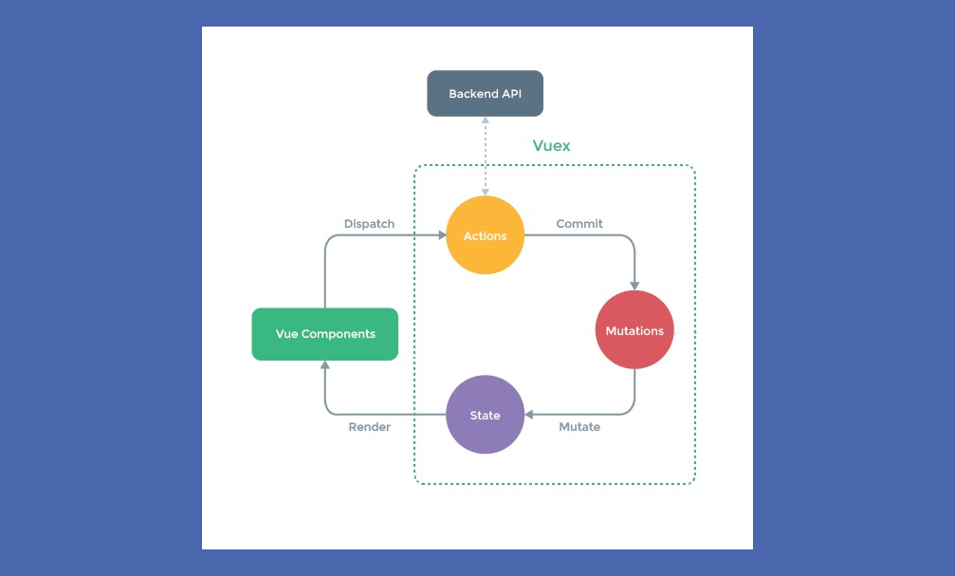

Slide 30
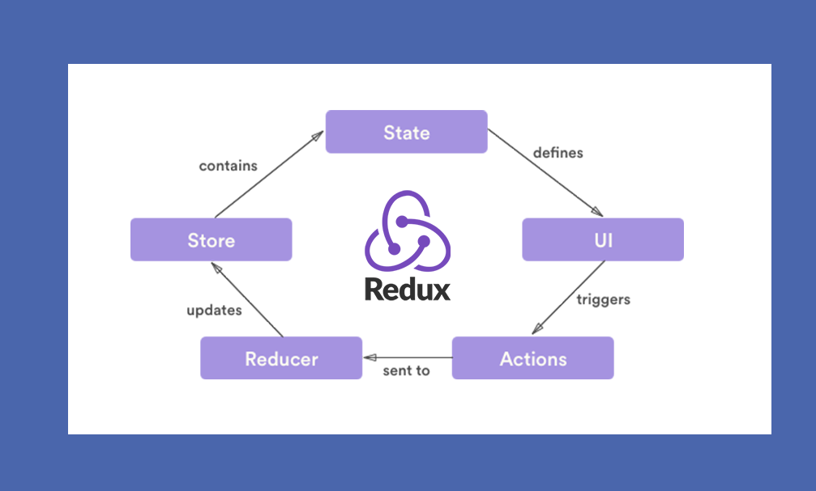

Slide 31
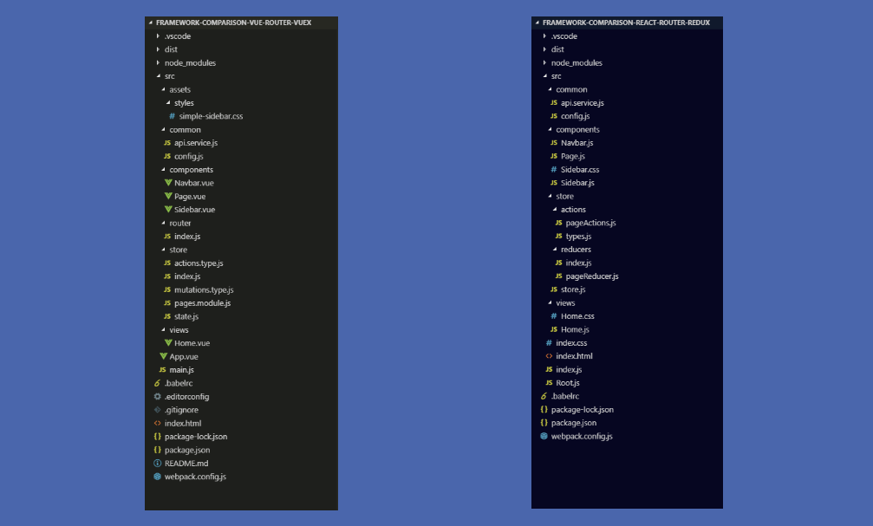

Slide 32
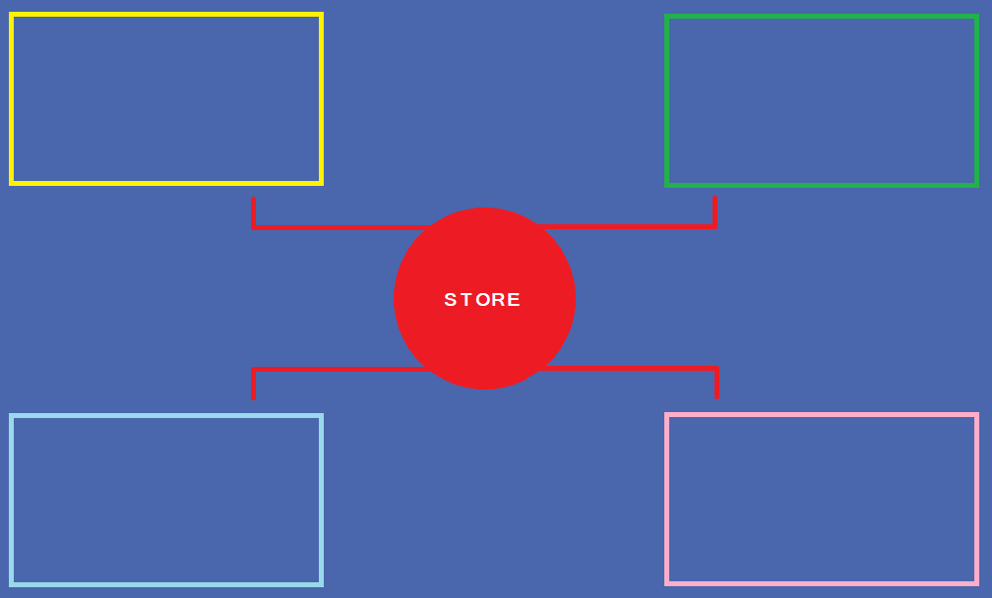

Slide 33
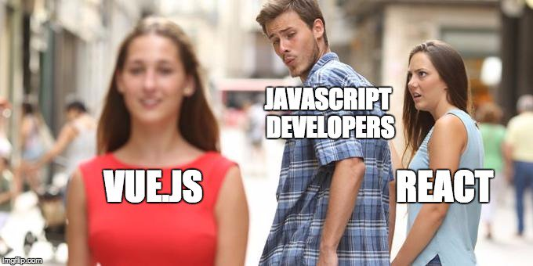

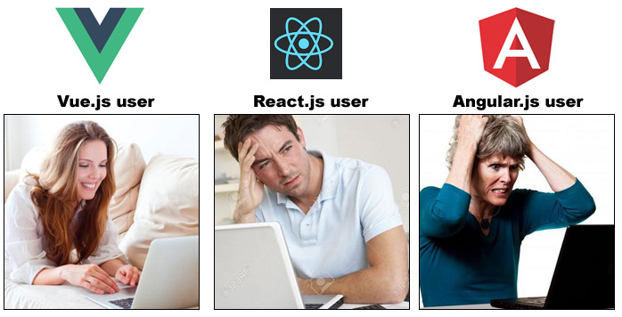
tiny.cc/vuevsreact

